Slide 1
Overview of Cognitive Science

Slide 2
What would an answer to this question look like?
What is a mind?
What is intelligence?
How do brains work? Neurons
Brain structure
What’s the difference between the brain and the mind?

Slide 3
What is a mind?
What do minds do?
Minds encompass our thoughts, which are mental processes that allow us to deal with the world. These include not only explicit wishes, desires, and intentions, but also unconscious processes.
Does MIND=BRAIN?

Slide 4
A “slippery slope” argument can convince us that minds are not literally brains, but encompass anything that is organized as representational states that accurately reflect aspects of the world.

Slide 5
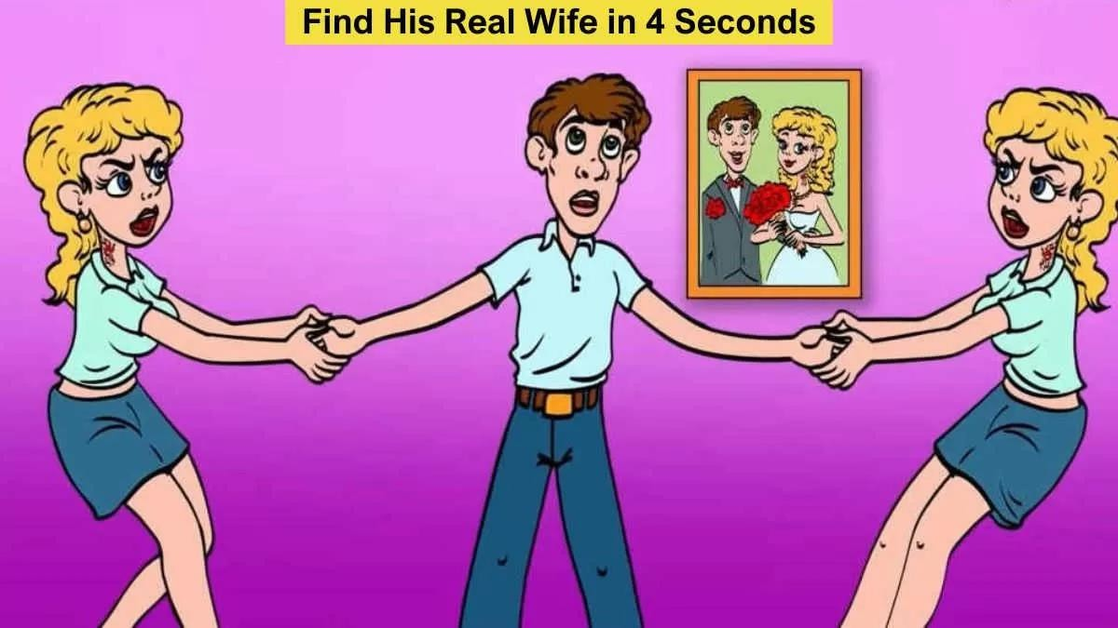
The Brain/Mind Riddle
What do you see in this picture?
What do you observe?
What do you see in this picture?
What do you observe?
We all agree upon what is viewed?
We all agree upon what is viewed?

Slide 6

https://timesofindia.indiatimes.com/life-style/health-fitness/de-stress/puzzle-can-you-tell-which-guy-is-lying-among-the- two/articleshow/99033446.cms?from=mdr

Slide 7
Minds as Computers
The key to minds is not their physical substrate, but the relations that states of the system have to one another, and to the external environment.
Minds aren’t human neurons or cat neurons or robot parts. They are dynamic, continually evolving systems that relate ongoing internal (i.e., mind) states and external (i.e., world) states
Correspondences can be made between two systems by describing what they do, independent of their exact physical substrate.

Slide 8
It can be defined as the complex network of thought processes and consciousness that arises from the neurological activity of the brain.
We can divide our mind into three layers: conscious, unconscious, and subconscious.
The conscious layer consists of our immediate thoughts, feelings, and memories, while the unconscious layer is composed of basic and primordial impulses, and the subconscious layer contains the memories and behaviors that we have acquired over time.

Slide 9
At its simplest, mind refers to our ability to think, feel, and engage in physical activity. The brain, on the other hand, refers to the physical organ in our head that supports these functions.
The brain is composed of neurons and blood vessels; on the other hand, the mind is abstract and is not made up of any neurons or blood vessels.
While the brain controls a person's movements,
emotions, and various bodily functions; the mind alludes to a person's morality, reasoning, and understanding.
The brain is a physical organ; it can be touched or
seen; however, the mind is intangible; it can neither be touched nor seen.

Slide 10
Cognition
Cognition – from Latin base cognitio – “know together”
The collection of mental processes and activities used in perceiving, learning, remembering, thinking, and understanding and the act of using those processes

Slide 11
Cognitive Processes
Learning and Memory
Thinking and Reasoning (Planning, Decision Making, Problem Solving ...)
Language
Vision Perception
Social Cognition
Dreaming and Consciousness

Slide 12
The mind as a computer analogy
Similarities: In what ways are they similar?
Most of the similarities address the processing of information.
Both Minds and computers…
Input information
Output information
Access information
Store information
Retrieve information
Analyze information

Slide 13
Representation
Symbolic Representation: information is coded in a discrete way with set values.
Propositions are statements about the world
and can be illustrated with sentences.
Rules are yet another form of representation that can specify the relationships between propositions.
Analog Representation : represent information in a continuous way

Slide 14
Language can serve as an example of a digital mental representation, and in fact verbal concepts seem to be the system of human symbolic representation that is most commonly used.
The basic elements of written language are letters.
These are discrete symbols that are combined according to a set of rules.
The combinations, or words, have meaning and are
themselves combined into other higher-order units, sentences, which also have semantic content.
The rules by which these word elements are combined and transformed in language are called
syntax.
Syntax constitutes the set of permissible operations on the word elements.

Slide 15
Example: Syntactic Disambiguation
“We shall discuss violence on TV.”
Two interpretations :
Sentence(S) Noun Phrase(NP) Determiner(Det) Verb Phrase(VP) Prepositional Phras)e(PP)
Verb(V) Noun(N)
Sentence(S)
Noun Phrase(NP)
Determiner(Det)
Verb Phrase(VP)
Prepositional Phrase(PP)
Verb(V)
Noun(N)
VP
VP
_{V} NP PP
discuss N
violence
V
discuss N
NP
P NP
PP
violence P NP
TV
on
on
TV

Slide 16
Visual images are the best example of mental analog representations.
Stop reading for a moment and close your eyes.
Imagine a picture of a palm tree on a sunny beach.
Can you see the pattern on the bark?
What about the coconuts?
Images capture many of the same properties as their referents, such as distances between corresponding sets of points.
The types of transformations that can be performed on images are also the kinds of changes that physical objects in the external observable world undergo.
These include rotations, translations, and reflections.

Slide 17
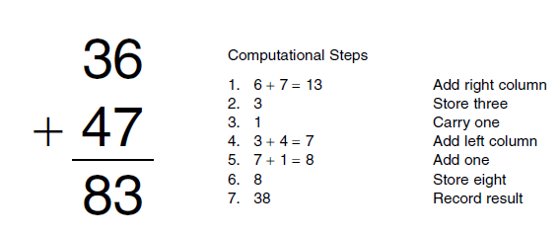
What is computation?
Rule-based manipulation of symbols.
S = str_replace( “cat” , ”c” , ”h” )
83

Slide 18
Three Levels of Description (David Marr)
A complete understanding of a computational system has to involve three (kinds of) levels :
Computational theory
What is computed and why.
What the system is capable of doing.
Representation and algorithm (software)
What program is used.
What are the symbols and how are they processed.
Hardware
Where in the brain?
What kind of neurons and how are they connected?

Slide 19
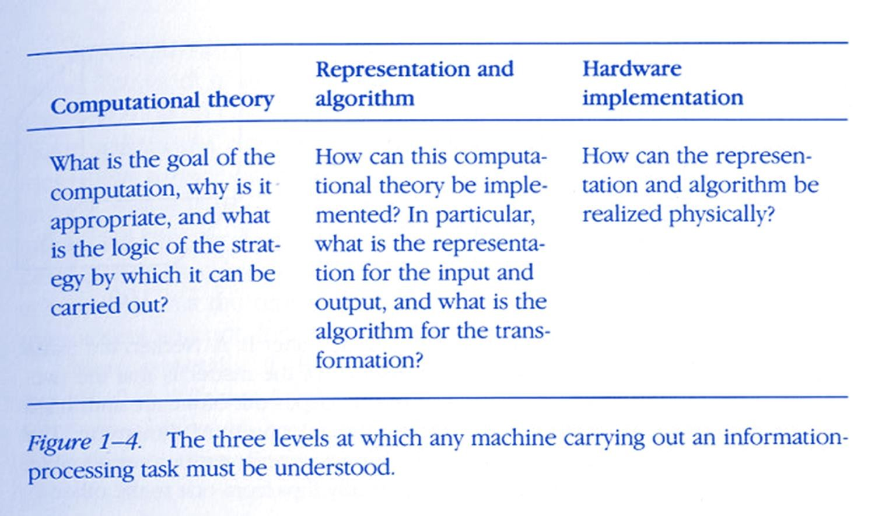

Slide 20
Computational level
--- What exactly is this problem?
--- What does this problem entail?
--- Why is this process here in the first place?
Algorithm :
--- actual way in which an information process is carried out.
implementational level:
---- What is the information processor made of? –
---What types of physical or material changes underlie changes in the processing of information?

Slide 21
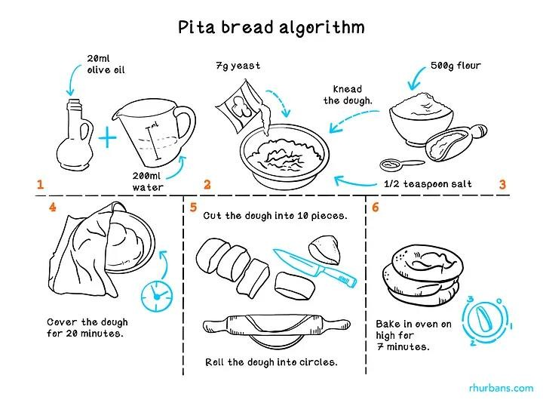
A program is like a cooking recipe

Slide 22
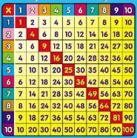
Example
Task: Multiplication. Input numbers x and y. Output x times y.
Algorithm:
Given inputs x and y, look up number z on row x and column y. Output z.
Implementation: human being and paper.

Slide 23
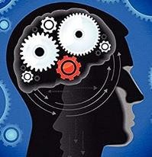
Alternative algorithm
How to calculate x times y:
If x =1, then answer is y.
If x>1, add y to itself (x) number of times. The result is the answer.
Example: 3x5 = 5+5+5 = 15
Implementation:

Slide 24

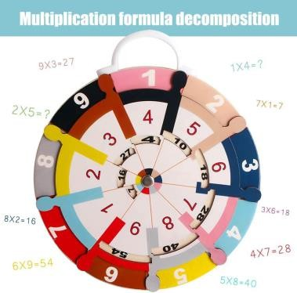
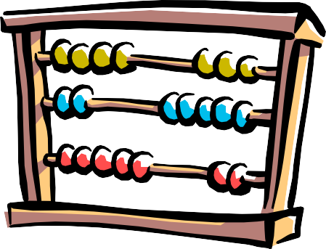
Two points
The same task can be performed with different algorithms.
Two different systems can do the same task in very
different ways.
The same algorithm can be implemented with different hardware.

Slide 25
How to study cognitive science
A computational theory of X should explain X at three levels.
What is computed? Visual motion
How? Correlate changes in luminance at different places.
Hardware? Comparator circuits

Slide 26
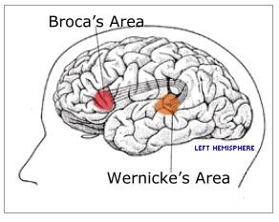
Application: linguistic understanding
Task
Identify syntax and meaning corresponding to speech sounds.
Algorithm
What kind of computation and mental representations?
Implementation
Which part of the brain?
VP
V
NP
PP
discuss
N
P
NP
violence
on
TV

Slide 27
So What IS Cognitive Science?
Some possible definitions:
“The interdisciplinary study of mind and intelligence”
“Study of cognitive processes involved in the acquisition, representation and use of human knowledge”
“Scientific study of the mind, the brain, and intelligent behaviour, whether in humans, animals, machines or the abstract”

